Slide 1
Build your first app
Android Developer Fundamentals V2
Lesson 1

Slide 2
1.4 Resources
to help you learn

Slide 3
Contents
Documentation
Tutorials and codelabs
Blogs and videos
Udacity courses
Source code for the practicals

Slide 4
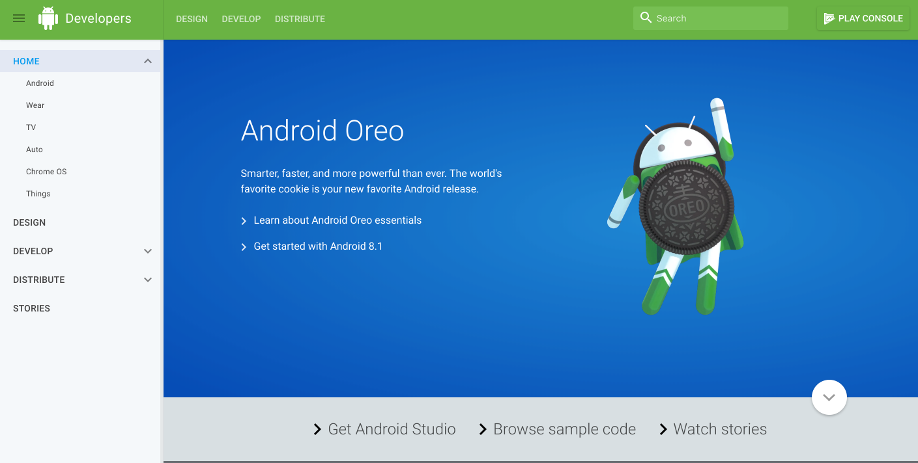
Official Documentation
developer.android.com

Slide 5
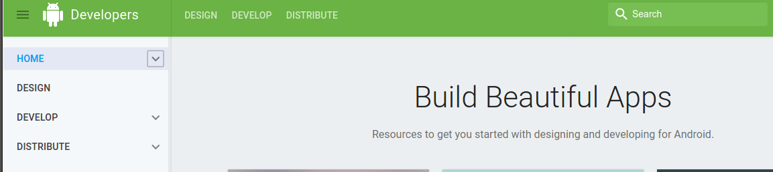
Documentation Structure
Search
DESIGN - UX approach using “Material Design”
DEVELOP - Software Developer Information, trainings, tutorials, sample code, reference
DISTRIBUTE - Delivering apps to users

Slide 6
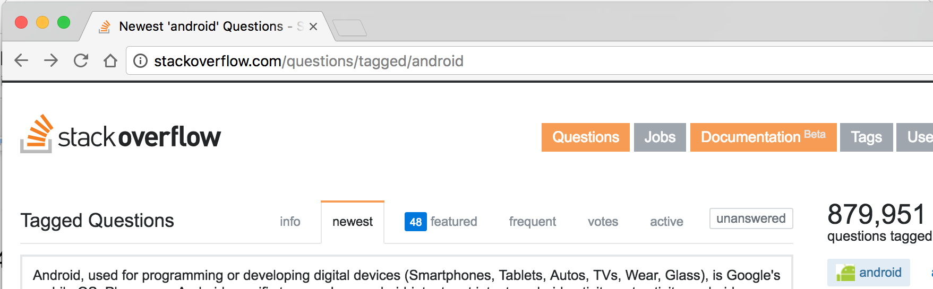
Stackoverflow.com
stackoverflow.com/questions/ tagged/android
Question/Answer format
Android, Java language, other programming topics

Slide 7
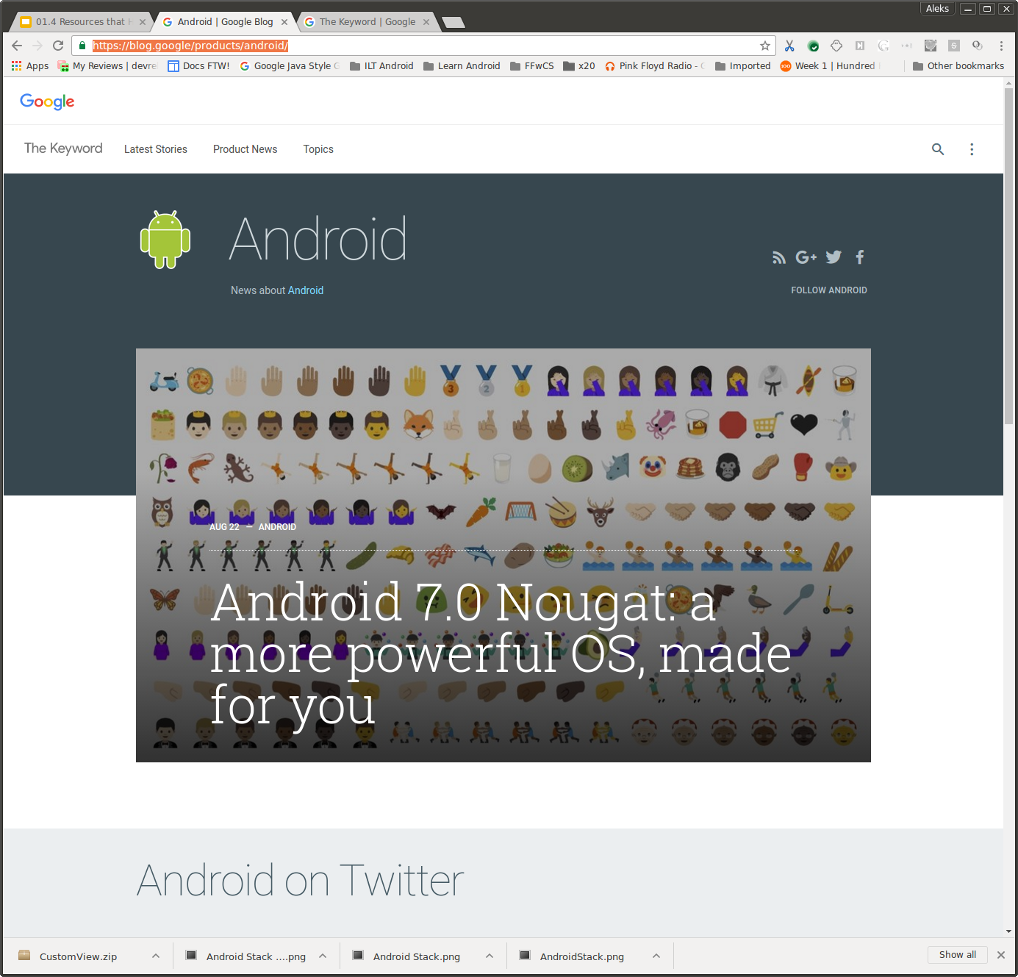
Official Android Blog
android.googleblog.com
News, features, high-level

Slide 8

Android Developers Blog
android-developers.blogspot.com
News, updates, developer stories, and articles on how to make your app successful
Notes:
News, updates, developer stories, and articles on how to make your app more successful.

Slide 9
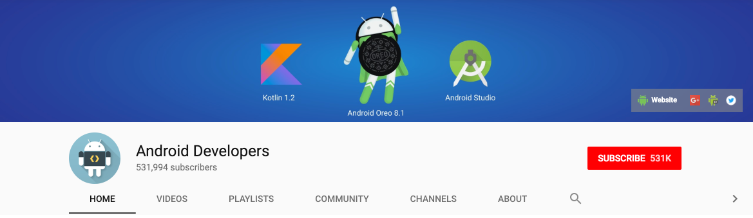
Android Developers YouTube Channel
Android Developers YouTube channel
News, tools, how to, and playlists around specific themes, such as Android Developer Patterns, Android Developer Stories, and Android Performance Patterns

Slide 10
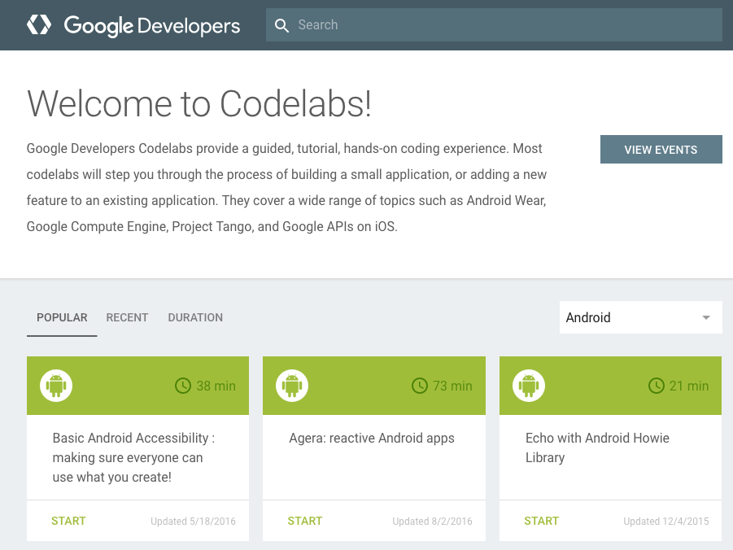
Google IO Codelabs
codelabs.developers.google.com
Short tutorials
about specific topics

Slide 11

Online Udacity courses
www.udacity.com/courses/android
Interactive video-based tutorials
Android courses are built by Google
Individual courses are free!
Pay for a Nanodegree
build a portfolio of apps
get a certificate

Slide 12
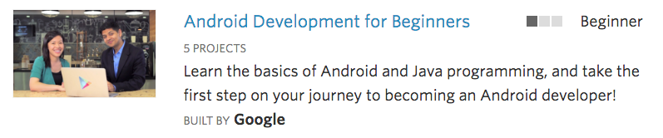
Udacity Android Course Topics
www.udacity.com/courses/android
Android for Beginners
Developing Android Apps for programmers
Advanced topics
Performance
Material Design
...

Slide 13
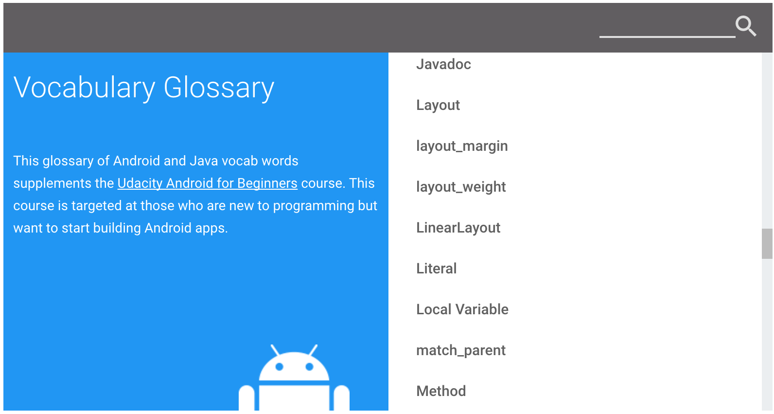
Android Vocabulary tool
developers.google.com/android/for-all/vocab-words

Slide 14
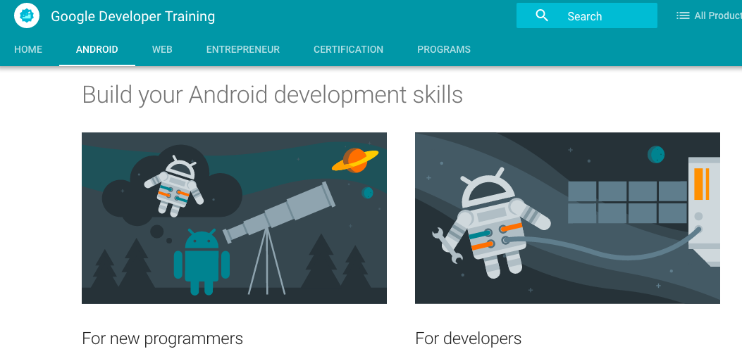
Google Developer Training website
developers.google.com/training
Course info
Programs
Certification details
Authorized Training Partners

Slide 15
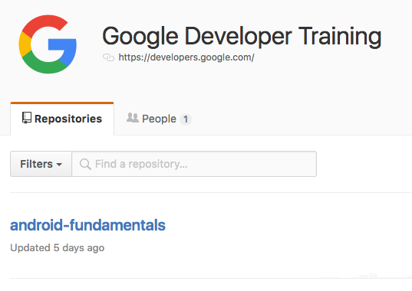
Source code for exercises on github
https://github.com/google-developer-training/android-fundamentals
Starter code and solutions for all the practicals and many of the challenges

Slide 16
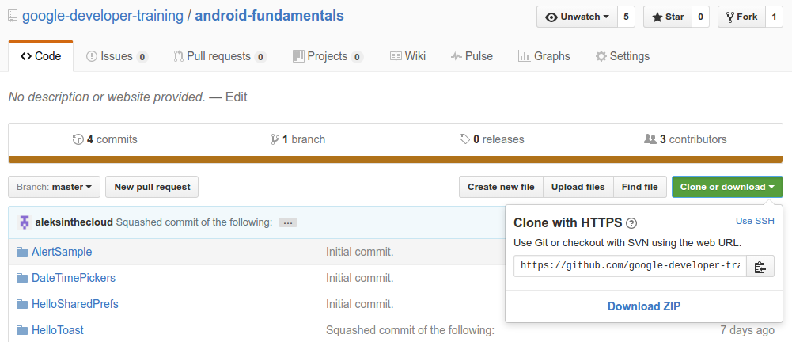
Download ZIP of repository (or clone)
1
2
3
Notes:
Clone or download the entire repository to get all the sample apps.

Slide 17
Get the most from the practicals
Complete each practical
Study and learn the corresponding concepts
Try completing the challenges
More detailed app that uses the concepts covered
Closer to real-world apps

Slide 18
Learn more
Official Android documentation
Get Android Studio
Create App Icons with Image Asset Studio
Official Android blog
Android Developers blog
Google I/O Codelabs
Stack Overflow
Android vocabulary
Google Developer Training website

Slide 19
Learn even more
Code
Source code for exercises on github
Android code samples for developers
Videos
Android Developer YouTube channel
Udacity online courses

Slide 20
What's Next?
Concept Chapter: 1.4 Resources to help you learn
Practical: 1.4 Available resources

Slide 21
END

